Slide 1
Accessibility Playbook
September 2026
Tools & practices to check for digital accessibility

Slide 2
Agenda
September 2026
Objective: Share the tools and practices your teams can use to measure and prioritize website accessibility with limited time and resources.
Context: Under Local Law 26 of 2016 the city has adopted WCAG 2.2 AA* as its standard for digital accessibility. A federal rule mandates April 26, 2027 as a deadline to meet WCAG 2.1 AA.
What does good look like?
Three recommended practices for all teams
Tools for advanced teams
* WCAG = Web Content Accessibility Guidelines. Commonly pronounced “wuh-cag”.

Slide 3
Catching up on previous accessibility guidance

Slide 4
All websites and mobile apps maintained by or on behalf of the City and content posted need to comply with WCAG 2.2 Level AA by April 26, 2027
Compliance is not required where the City can demonstrate that compliance would constitute an undue burden or result in a fundamental alteration to a program, service or activity.​

Slide 5
Exceptions to federal DOJ rule
Exceptions relevant to NYC websites are *highlighted. As communicated on the Fact Sheet: New Rule on the Accessibility of Web Content.
*Archived web content (kept only for reference)
Preexisting conventional electronic documents
Content posted by a third party (e.g. comment board)
Individualized documents that are password-protected
Preexisting social media posts
Other Information About Complying with the Rule
*Use of Conforming Alternate Versions
*Effect of Noncompliance That Has a Minimal Impact on Access.

Slide 6
Previous guidance
Outdated content
Best way to be compliant is to remove outdated content based on our content removal policy. Agencies have been asked to do this with TeamSite websites by September 30, 2026.
PDFs
Moving forward, it’s best to be HTML-first with your content and avoid PDF formats.
If PDFs are necessary, OTI has created accessible report templates available for download here.

Slide 7
Previous action items
CIOs: Install Microsoft Word templates
Install the Microsoft Word templates into your agency SharePoint as soon as possible.
Communicate to your teams
Communicate to your agency teams about accessible report templates and that we need to comply with digital accessibility standards by April 26, 2027.
September 30, 2026
Complete auditing and removing old and unused TeamSite content. See guidance.
April 26, 2027
Prioritize accessibility compliance for your most impactful and used websites and solidify plans for any remaining compliance work.

Slide 8
What does good look like?

Slide 9
Scope of these recommendations: websites, not PDFs
✓​
Websites & web applications
✓
How to identify accessibility issues
✓
Tools to measure progress
✘
PDFs
See June's town hall deck for PDF best practices.

Slide 10
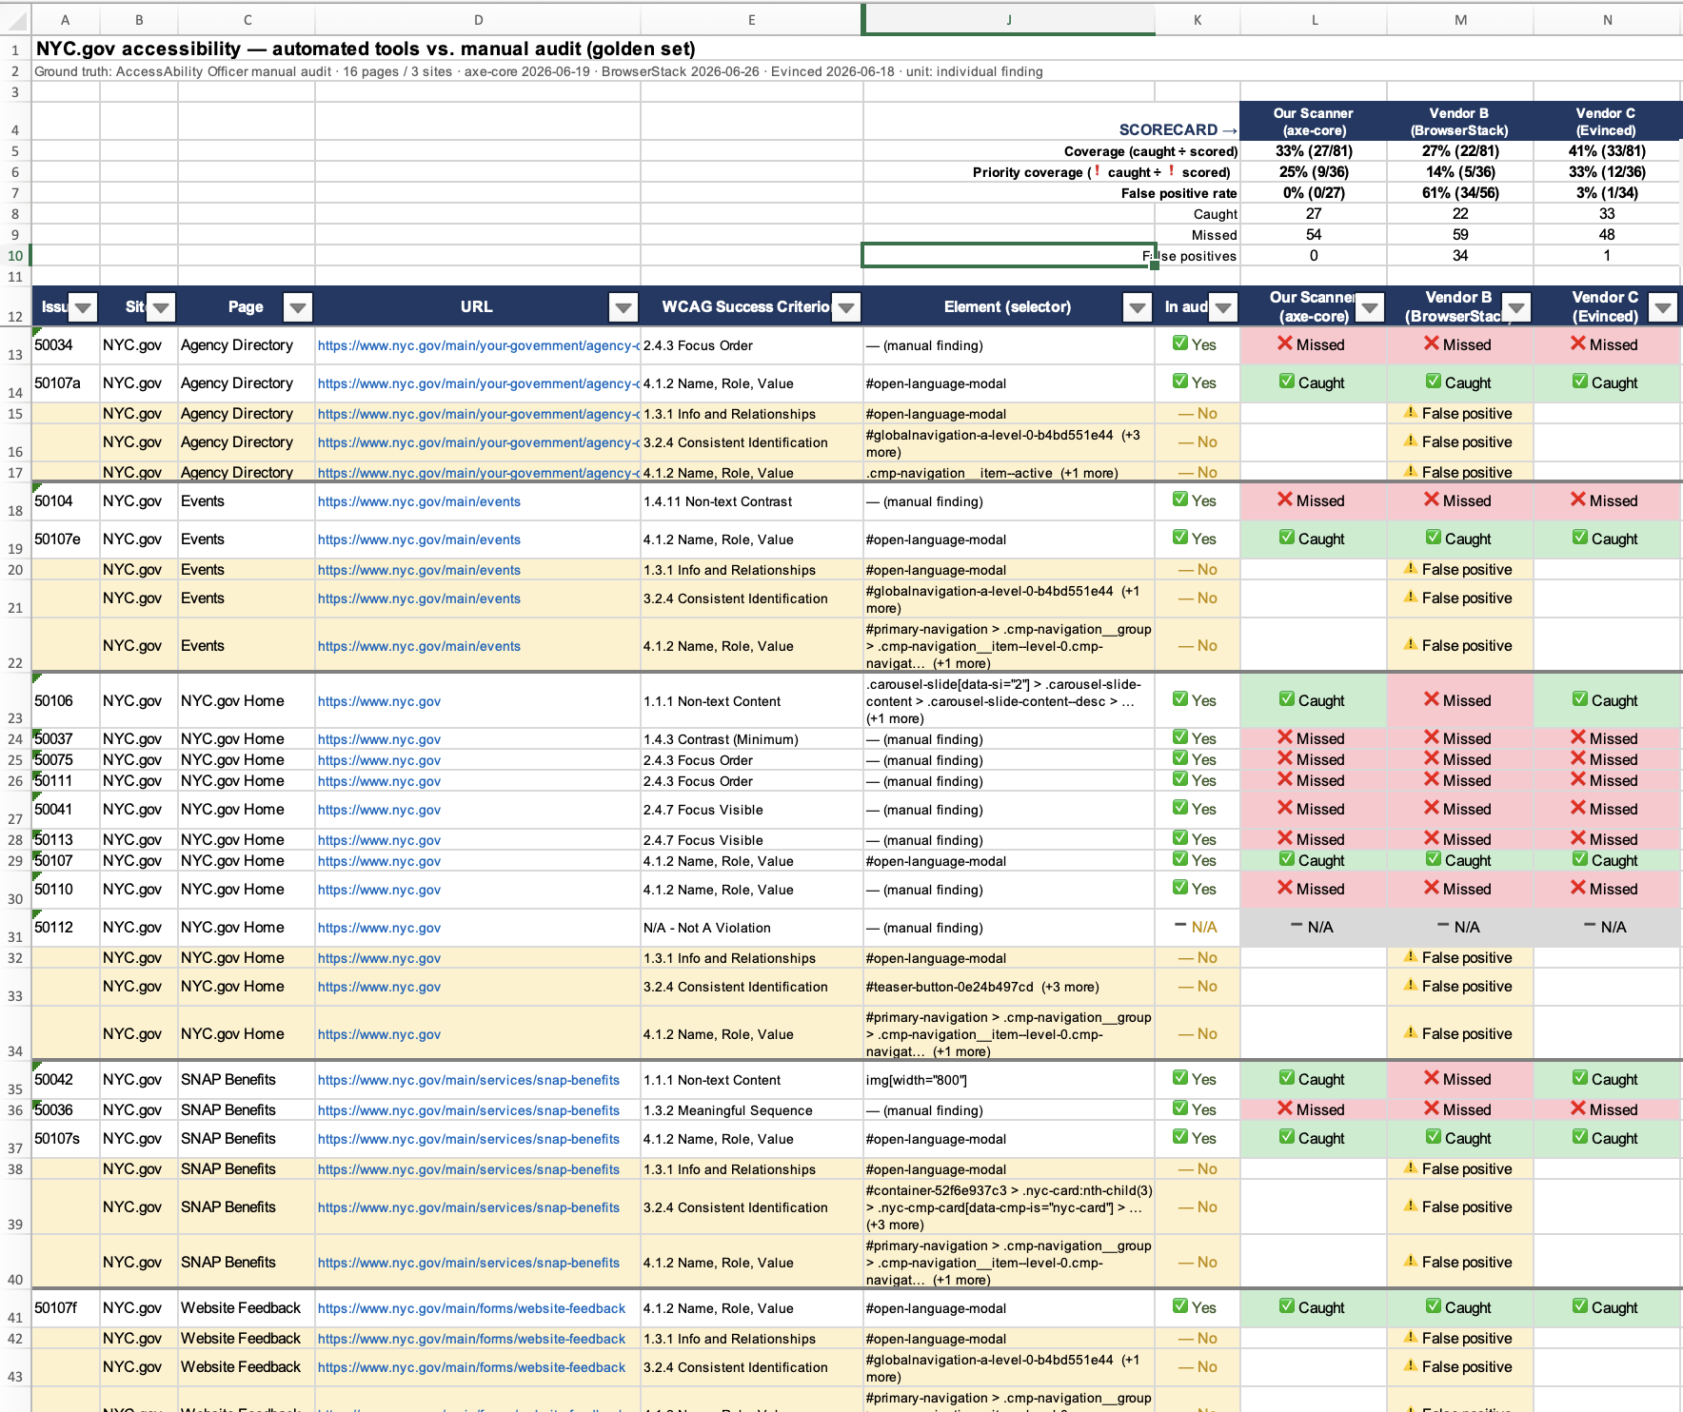
There’s no one magic tool
Existing tools are limited in coverage or flag too many “potential” issues to measure accessibility on their own.
Limited coverage
Automated tools can only ever check for 30-40% of issues (see Appendix), so scores are misleading. Most are built on the same open-source library called axe-core.
Noisy suggestions create extra work to review
Some tools flag many "potential" issues that are hard to verify unless you are an expert yourself. An example is WebAIM’s WAVE tool, which we don’t recommend for most teams.
Prioritizing "no false positives"
We prioritized finding tools such that every flagged issue would be worth your time.
OTI verified vendor claims by comparing various tools to expert manual audits (see Appendix)

Slide 11
What does good look like?
You can feel confident your websites and digital products are accessible if the following are true. For existing products prioritize #1 and #2.
Getting started | Accessible by design You’ve confirmed with an accessibility expert that your designs are compatible with keyboard and screen reader users (using the NYC Design System when possible). No serious issues from accessibility expert feedback You’ve addressed all the most serious feedback from an accessibility expert on issues that block New Yorkers altogether (e.g. “P0”, “P1” priority feedback).
Good | Zero unexplained issues in FastPass (Steps 1 and 2) Using the Accessibility Insights browser extension, you’ve run FastPass and verified that there are no unexplained failures in Steps 1 and 2. Across three viewports: desktop view, 200% zoom, and mobile view
Stellar | You've used a screen reader to test the product yourself To test usability and build intuition for how New Yorkers experience your work. Accessibility is checked at scale by automated testing Your team has incorporated the axe-core rule engine into test suites and site crawling

Slide 12
Getting to good

Slide 13
Three recommendations for all teams
These three tools and practices will make the biggest difference in helping teams quickly evaluate whether websites are accessible and identify issues to prioritize fixing
Design
Development
Launch
1. Share a design mockup for feedback at office hours*
  Why: avoid implementing designs that can never be made accessible
  When: before designs are finalized
  Goal: address feedback on design patterns that block keyboards & screen readers
2. Use the FastPass test (Accessibility Insights browser extension)
  Why: quickly identify most accessibility issues with this free browser extension
  When: early and often in development or production
  Goal: zero unexplained failed instances on Step 1 and Step 2 of the test.
3. Share engineering prototype for feedback at office hours*
  Why: verify that a screen reader can use your website
  When: before engineering is finalized
  Goal: address feedback on the most serious issues blocking usability (e.g. "P0" and "P1")
*Or with an equivalent accessibility expert

Slide 14
Why start with design feedback?
1) Design mockups
Focus on usability first
Most important is that New Yorkers can use your website to get the information they need and access essential services. The same is true for New Yorkers who need a keyboard or screen-reader to access our websites.
2. Human judgement is essential
No tool can tell you with 100% confidence that your site is usable. Only a person can do that. Since most of us are not fluent in screen readers, we rely on the advice of those who do (for example, accessibility experts in office hours).
3. Usability contributes to legal compliance
The DOJ ruling makes an exception for minimal impact: if the mistake is "so minor that it would not change a person with a disability’s access to the content" ... "then they are not violating the rule."

Slide 15
1) Share design mockup for review
1) Design mockups
Recommendation: Receive feedback from an accessibility expert on a mockup before finalizing designs
Goal: Address feedback on design patterns that may block keyboards and screen readers
How to solicit feedback
MOPD's Accessibility Office Hours
Every Friday 10-11am
Hosted by Arthur Jacobs
(ajacobs2@mopd.nyc.gov)
Office hours booking link
For most agencies this means visiting MOPD’s accessibility office hours. Arthur Jacobs can test your website using a screen reader and advise you on which issues to prioritize.
Some agencies may already be working with consultants who are accessibility experts and can provide the same advice. We can recommend two: AccessAbility Officer and Deque. The city has a contracting vehicle with NIBNY as a preferred source provider for accessibility testing. As a first step, contact your Agency Chief Contracting Officer (ACCO).
MOPD = Mayor’s Office for People with Disabilities (site)

Slide 16
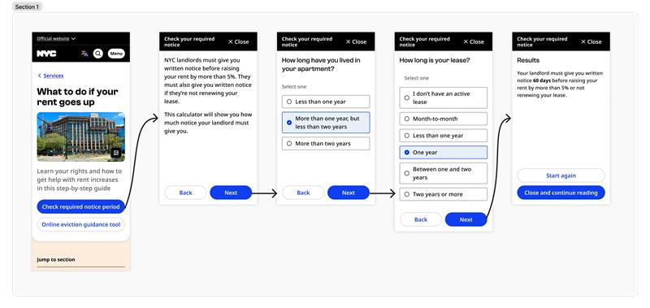
Example of a design mockup
1) Design mockups
Before engineering has started, teams can use design mockups​ to walkthrough proposed screens in order. It’s important to get feedback at this early stage to avoid wasting time and effort on designs that can never be made accessible.

Slide 17
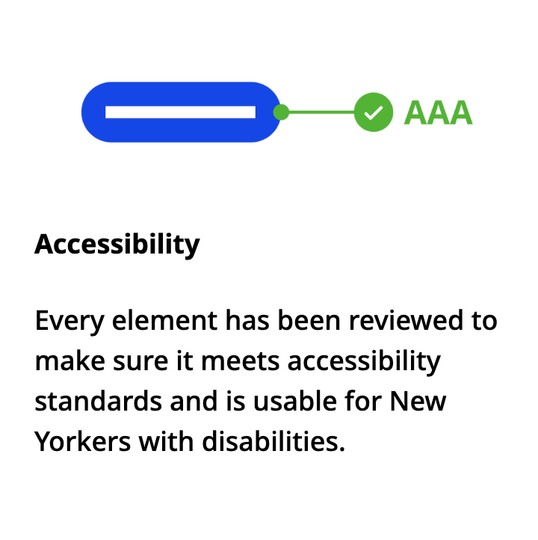
Be accessible by design using the NYC Digital Design System
1) Design mockups
The NYC Digital Design System is a set of rules and reusable parts for making digital products for NYC government. It’s based on user needs and accessible by design.
Reach out to get started and learn more on the design system website.

Slide 18
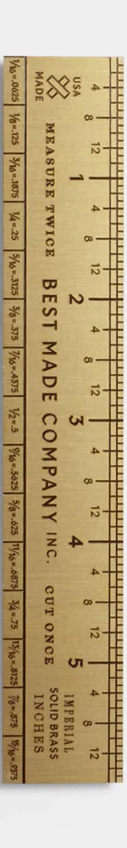
Why use FastPass?
2) FastPass test
We recommend all teams use the FastPass test (on the Accessibility Insights browser extension) because it prioritizes "no false positives" and incorporates simple manual testing.
Every issue worth your time
The FastPass test uses an open-source rule engine with a philosophy of “no false positives”. Instead of flooding you with suggestions, it only flags those issues that it is 99% confident about. Checks against WCAG 2.2 AA by default.
Simple manual testing
FastPass also incorporates very simple manual testing as part of the test. This lets us catch ~60% of issues altogether in just a couple of minutes.
FastPass is the only tool we can recommend as a "ruler" to measure your progress.

Slide 19
2) Use FastPass early and often
2) FastPass test
Recommendation: use FastPass early and often throughout development to catch accessibility issues as soon as they appear
Goal: zero unexplained issues on Step 1 (Automated checks) and Step 2 (Tab stops).
How to use this tool
Download browser extension Accessibility Insights
Available on Chrome & Edge browsers
Open-source and approved by Cyber Command
Link to official documentation
Microsoft created the Accessibility Insights tool for internal use and makes it available to the public.
Its FastPass test provides clear guidance for anyone to check for most accessibility issues in a couple of minutes. Microsoft recommends that its engineers use FastPass every time they commit code.

Slide 20
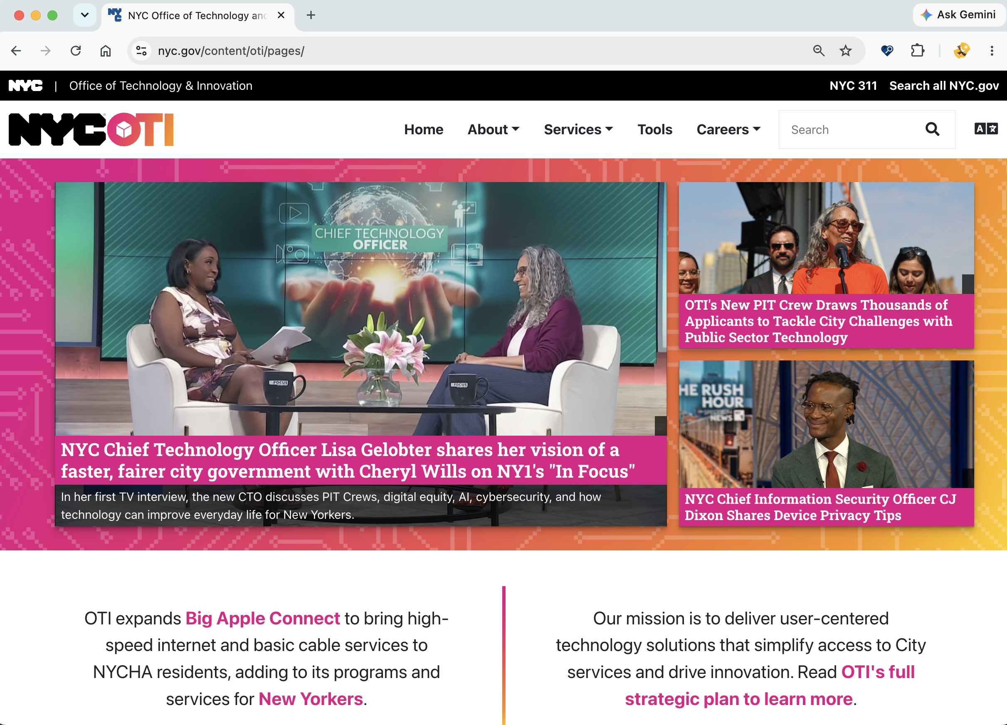
The FastPass test
2) FastPass test
Starting testing a website with FastPass in just two clicks:

Slide 21
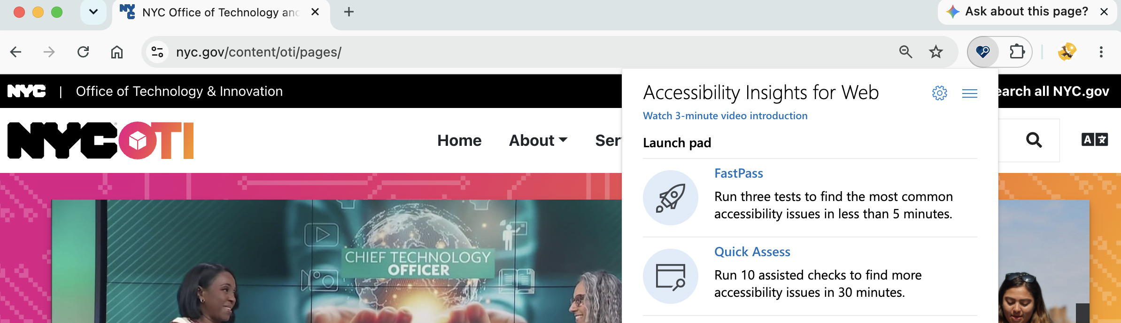
The FastPass test
2) FastPass test
Starting testing a website with FastPass in just two clicks: (A) Open the Accessibility Insights extension icon
A

Slide 22
The FastPass test
2) FastPass test
Starting testing a website with FastPass in just two clicks: (A) Open the Accessibility Insights extension icon and (B) select FastPass from the menu.
#2 FastPass test
B

Slide 23
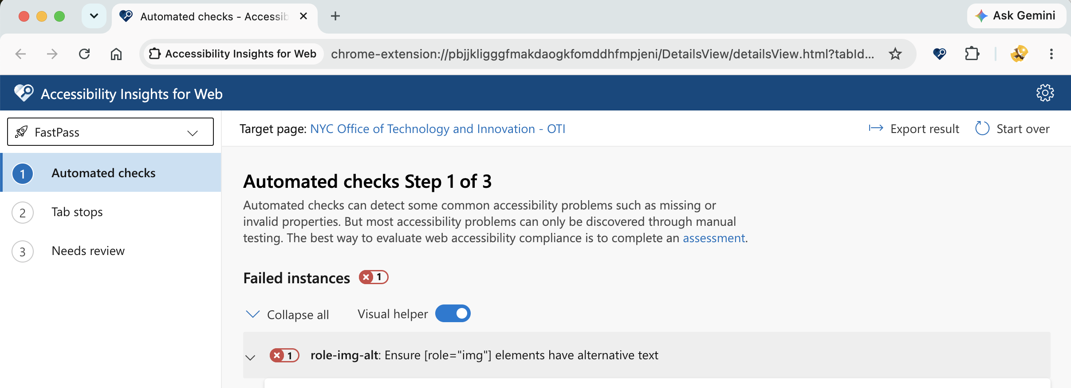
The FastPass test
2) FastPass test
This automatically opens a new window in your browser with the test results from Step 1 of FastPass (Automated checks).

Slide 24
The FastPass test
2) FastPass test
(C) Clicking any issue highlights the relevant component in the original window and provides context a developer needs to fix the issue.
C

Slide 25
The FastPass test
2) FastPass test
(C) Clicking any issue highlights the relevant component in the original window and provides context a developer needs to fix the issue. (D) ”Export result” to download results and share with others.
D

Slide 26
The FastPass test
2) FastPass test
(C) Clicking any issue highlights the relevant component in the original window and provides context a developer needs to fix the issue. (D) ”Export result” to download results and share with others. (E) Select “Tab stops” to continue to Step 2.
E

Slide 27
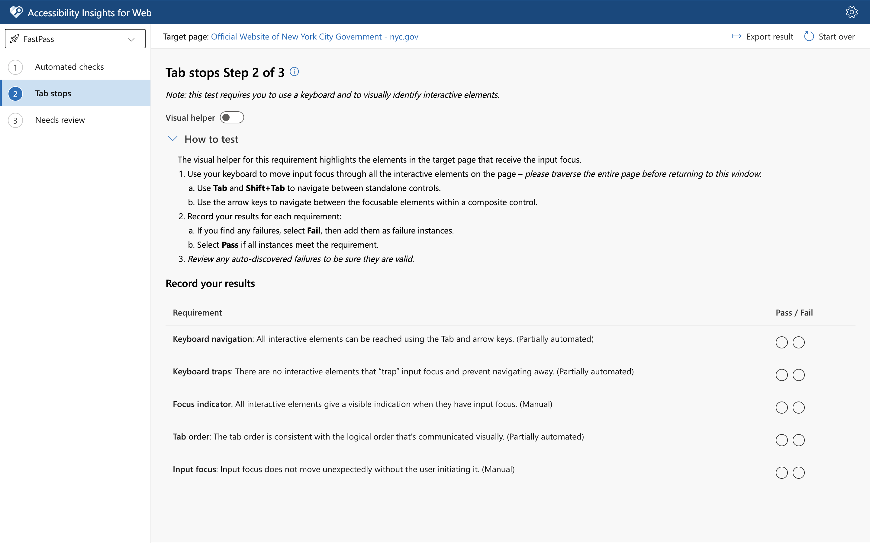
The FastPass test
2) FastPass test
Step 2 looks complicated to start but is surprisingly simple.

Slide 28
The FastPass test
2) FastPass test
Step 2 looks complicated to start but is surprisingly simple. (F) Start by toggling "Visual helper"
F

Slide 29
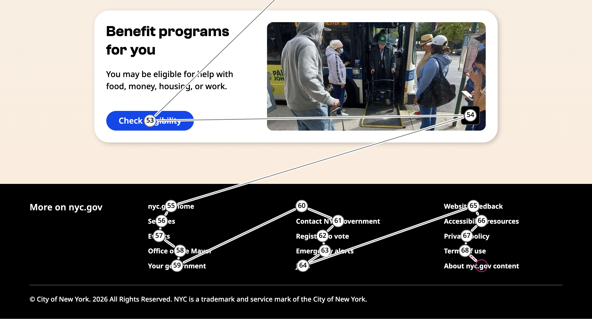
The FastPass test
2) FastPass test
Now in the original window, you can use your computer's tab key to visit every interactive element until you reach the end of the page you’re testing. (G) FastPass will number every element you visit.
G

Slide 30
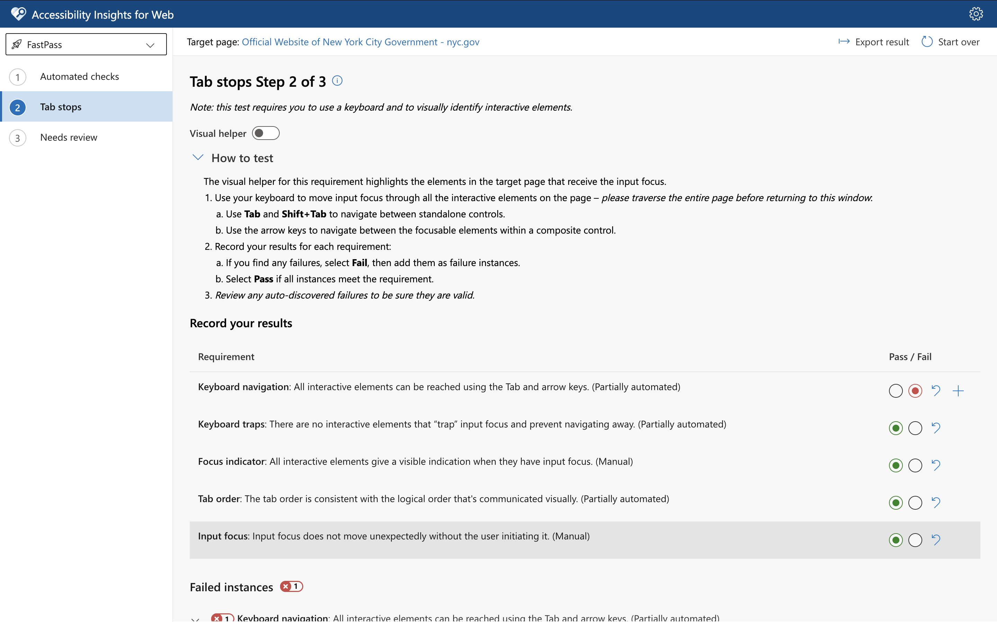
The FastPass test
2) FastPass test
Returning to the FastPass window, (H) some issues will be automatically detected.
H

Slide 31
The FastPass test
2) FastPass test
Returning to the FastPass window, (H) some issues will be automatically detected. (I) Answer the five questions (Pass / Fail) yourself to complete the test.
I

Slide 32
The FastPass test
2) FastPass test
You're done! (J) “Needs review” provides suggestions and can be disregarded.
J

Slide 33
3) Share engineering prototype for review
3) Engineering prototype
Recommendation: Receive feedback from an accessibility expert again before finalizing engineering.
Goal: Address highest priority feedback items to ensure screen readers can access (e.g, "P0", "P1")
How to solicit feedback
For most agencies this means visiting MOPD’s accessibility office hours. Arthur Jacobs can test your website using a screen reader and advise you on which issues to prioritize.
Consultants who are accessibility experts can provide the same advice. We can recommend two: AccessAbility Officer and Deque. The city has a contracting vehicle with NIBNY as a preferred source provider for accessibility testing. As a first step, contact your Agency Chief Contracting Officer (ACCO).
Accessibility Office Hours
Every Friday 10-11am
Hosted by Arthur Jacobs
(ajacobs2@mopd.nyc.gov)
Office hours booking link
MOPD = Mayor’s Office for People with Disabilities (site)

Slide 34
Going further

Slide 35
Further impactful recommendations
For teams that have the resources to go further and are already comfortable with the previously recommended interventions
Screen reader testing
Learn to use NVDA or VoiceOver to test your products and build intuition for navigating our websites by screen reader
  Reach out to MOPD for training
Check accessibility at scale with axe-core
Integrate axe-core, the open-source rule engine, with your test suites and site crawling.
  Reach out to OTI for examples or access to site scanner prototype

Slide 36
Next steps (Nov 1st target date)
Communicate
Share widely with teams creating public-facing sites and applications
CIOs: Enable browser extension Accessibility Insights
Enable your organization to access this browser extension on Chrome & Edge
Visit accessibility office hours for feedback on existing websites in need of remediation
Sign up for office hours or email Arthur Jacobs (ajacobs2@mopd.nyc.gov) at MOPD.
Share your learnings
OTI is learning alongside agencies how best to implement recommended tools. We value your feedback on what works.

Slide 37
Q&A

Slide 38
Appendix

Slide 39
Comparing Accessibility Tools
Appendix
Process: 16 URLs across 3 sites (NYC.gov, MOPD, DOT) were picked for our “golden set”. We scored the open-source rule-engine axe-core and two vendors (BrowserStack & Evinced) against manual audits conducted by experts at AccessAbility Officer.
Results: No fully automated tools (no human intervention at all) can catch more than 30-40% of accessibility issues with perfect confidence. The open-source option, axe-core, fulfilled its ”zero false positives” promise.
 | axe-core | Vendor A (BrowserStack) | Vendor B (Evinced)
Coverage (caught ÷ scored) | 33% (27/81) | 27% (22/81) | 41% (33/81)
Priority coverage (caught ÷ scored) | 25% (9/36) | 14% (5/36) | 33% (12/36)
False positive rate | 0% (0/27) | 61% (34/56) | 3% (1/34)
Caught | 27 | 22 | 33
Missed | 54 | 59 | 48
False positives | 0 | 34 | 1

Slide 40
WCAG 2.2 coverage
Appendix
A simplified breakdown of how many WCAG issues are covered by each accessibility test. As explained earlier, we can identify ~60% of WCAG 2.2 issues using FastPass (steps 1 and 2). For the remaining 40% we rely on accessibility office hours and screen reader testing.
% of WCAG 2.2 | Accessibility intervention
~30% | FastPass Step 1 (Automated checks) |  |  | MOPD Office Hours (or feedback from another accessibility expert)
~30% |  | FastPass Step 2 (Tab stops)
~30% |  |  | Screen reader testing (NVDA & VoiceOver)
~10%

Slide 41
How to use
Accessibility Insights for Web
Appendix
(Read official documentation and instructions here.)

Slide 42
Screen reader testing
Appendix
Recommendation: Learn how to use a screen reader to test your website before finalizing engineering
Goal: Your team regular tests websites by screen reader to ensure essential information and services are easy to access
How to get started
Attend screen reader training with MOPD
Learn how to use a screen reader by attending a 1-hr training session
Email Arthur Jacobs (ajacobs2@mopd.nyc.gov)
It's hard to build intuition for how a visually-impaired New Yorker if you've never used a screen reader yourself.
Luckily there are great open-source options: NVDA is a screen reader for Windows that is free to download and can be used without installation (approved by Cyber Command). VoiceOver comes preinstalled on all Macs.
MOPD offers training sessions for teams on how to use a screen reader.

Slide 43
Check accessibility at scale w/ axe-core
Appendix
Recommendation: check accessibility at scale by running axe-core in your automated test suites and site-wide crawling
Goal: catch accessibility issues before code enters production and monitor sitewide progress
How to get started
Using axe-core
GitHub: axe-core
OTI can provide examples of integrating axe-core with test suites
Covers ~30% of issues in WCAG 2.2 AA
Axe-core is the industry-standard open-source rule engine that powers many accessibility tools (including Accessibility Insights, our recommended browser extension). It was developed by Deque with a "no false positives" philosophy.
OTI has experimented with a site scanner prototype that can scan entire sites and aggregate results across multiple URLs. Reach out to learn more.

Slide 44
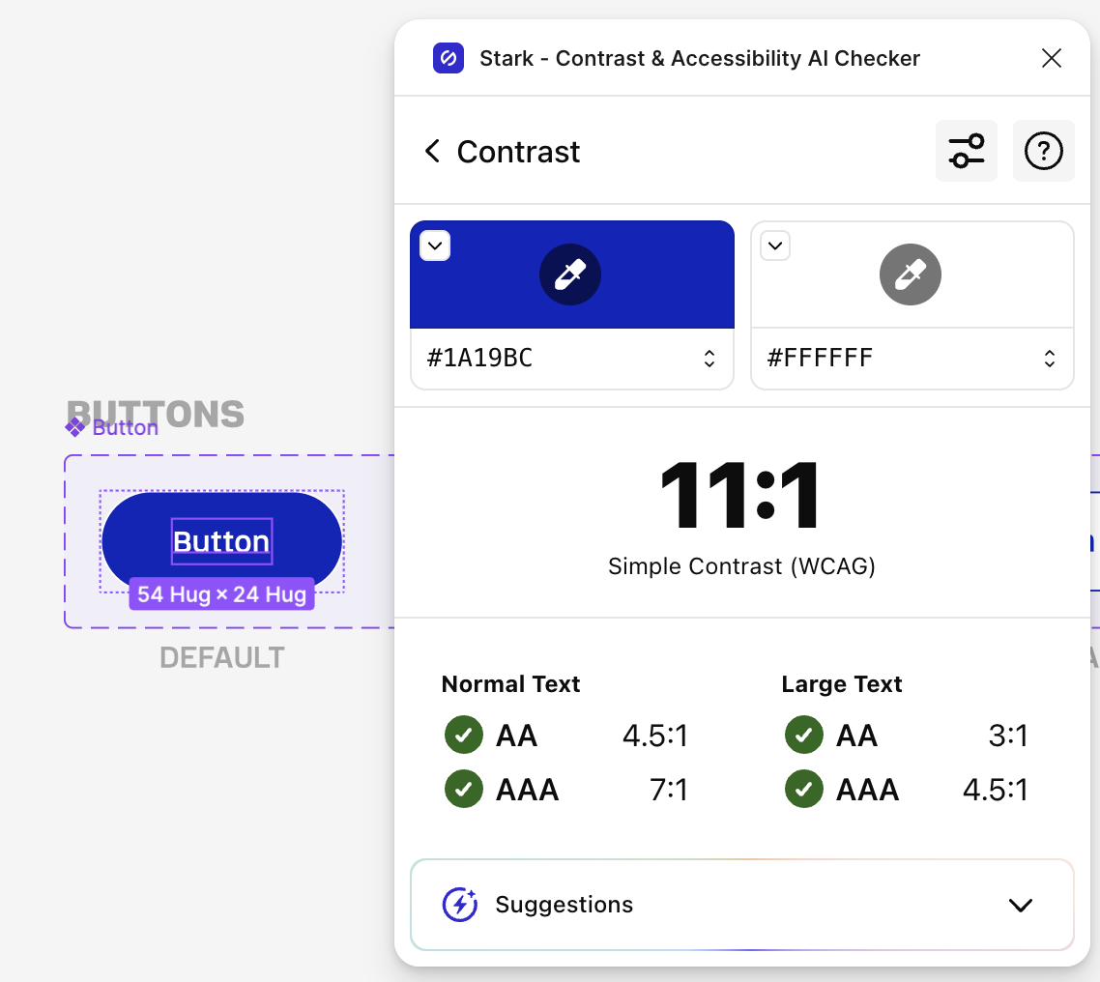
Color contrast
Appendix
FastPass Step 1 in the Accessibility Insights for Web browser extension already covers color contrast at the AA level necessary for DOJ compliance. Designers are encouraged to verify color contrast at the higher AAA standard before engineering begins..
Color contrast
OTI recommends using the WCAG AAA standard for text color contrast (7:1 for normal text, 4.5:1 for large text).
Recommended tool: Adobe Color Contrast Analyzer
Adobe’s free online tool checks for WCAG color contrast given two hex values.
Recommended tool: Stark
For designers using Figma, Stark is a freely available plugin that checks for WCAG color contrast.

Slide 45
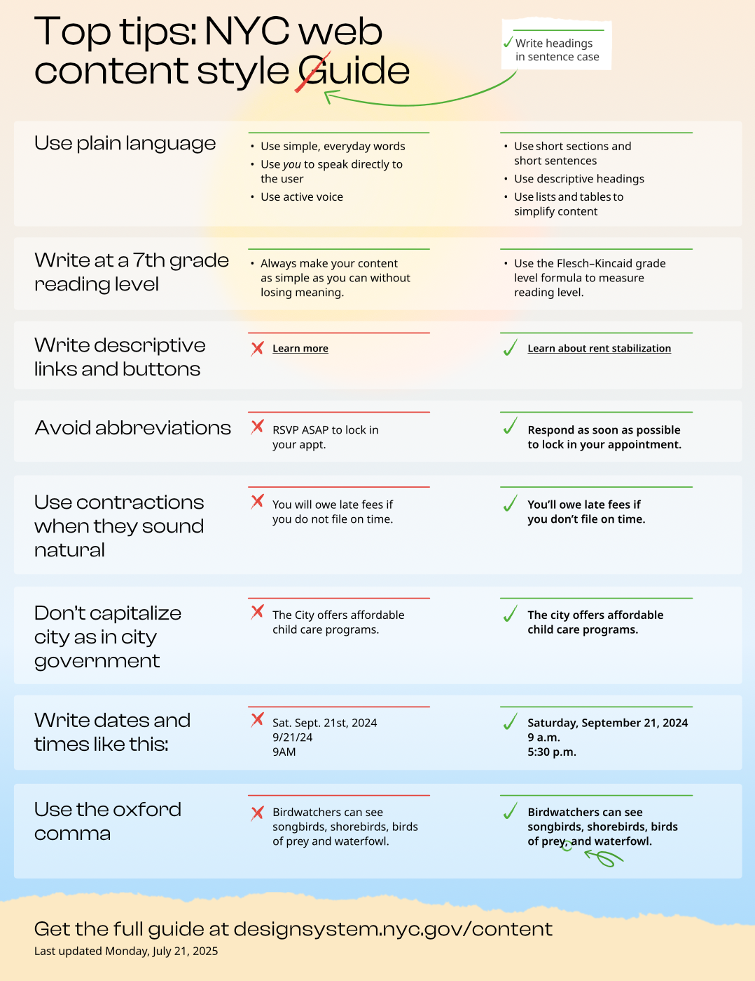
Writing in plain language
Appendix
Impactful for New Yorkers of all reading levels, but not required by WCAG 2.2 AA
Write for a 7th grade reading level
We recommend writing at a 7th grade reading level so that text is accessible to all New Yorkers. The goal is to write simply without losing meaning.
NYC web content style guide
Refer to the NYC web content style guide’s 1-pager Top Tips for more guidance on creating clear content for city websites.
Recommended tool: Microsoft Word
Instructions for using Word to check for reading level documented here. (Uses recommended Flesch-Kincaid scoring).
Top Tips 1-pager: https://designsystem.nyc.gov/standards/nyc-web-content-style-guide/top-tips.html

Slide 46
FAQs
Appendix
The citywide standard is WCAG 2.2 AA, but the DOJ ruling references WCAG 2.1 AA. Why the discrepancy?
  The ultimate goal with all of our accessibility work is that city websites and services are usable for all New Yorkers. Since technology is fast evolving, WCAG periodically updates its guidance and the city updates its standard accordingly. If your website already meets WCAG 2.1 AA, that is great news. This means the site satisfies the DOJ ruling (pending further updates) and is very close to the citywide standard.
When I check Google (or another high traffic public site) using the FastPass browser extension test I see a lot of errors. Why?
  In many cases these organizations are doing some advanced engineering (e.g. invisible tabs stops that auto forward a screen reader to the next location) that are aren’t relevant for the vast majority of our sites. We should aim for zero errors unless we have a very good reason not to.
The FastPass browser extension is triggering an error for my embedded YouTube video. What do I do?
  This is a known issue and limitation of YouTube, and there’s nothing we can change as a city if we must embed a video from that platform.
How to check for color contrast if not using Figma?
  The FastPass test on Accessibility Insights also checks for color contrast

